Slide 1
Design Patterns GoF Factory Method and Simple Factory

Slide 2
Creating objects
Creating objects is an inherent necessity of object-oriented programming
However, when we create objects we also bind ourselves to a concrete implementation:
class House
{
private readonly Bedroom _bedroom;
private readonly Kitchen _kitchen;
private readonly FrontDoor _door;
public House()
{
_bedroom = new Bedroom();
_kitchen = new Kitchen();
_door = new FrontDoor();
}
}
Concrete objects

Slide 3
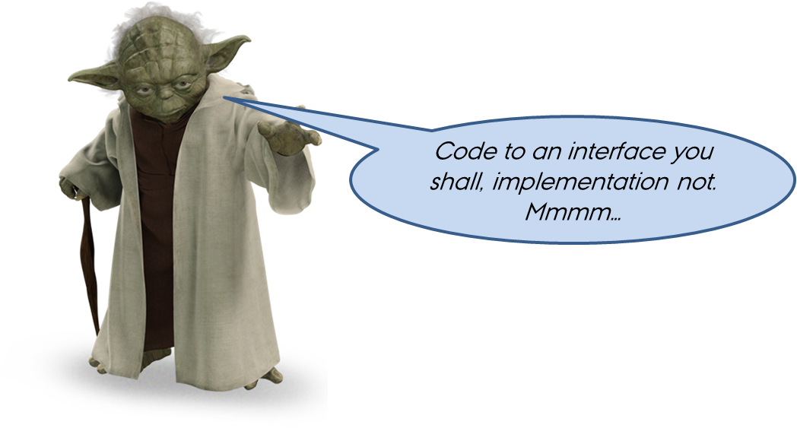
Remember Master Yoda?
Coding to an interface insulates us from the impact of change
But at some point we will need to create the concrete objects
Startup -> Constructor injection
Run-time creation of objects?
When object creation becomes a responsibility of its own, and/or when types vary over time, it’s time to use factories
Notes:
If we only know a class through its interface, the concrete implementation of the interface can change without changes to the rest of the software. OCP! OCP! OCP!!!

Slide 4
Factories in software design
The general idea of factories is to separate creation of objects from their use.
Testability, SRP, OCP, configurability, maintainability, …
Factories come in many different flavors – we will look at two classics:
GoF Factory Method: Define an interface for creating an object, but let the classes that implement the interface decide which object to instantiate.
Simple Factory: Define a factory for creating objects

Slide 5

GoF Factory Method

Slide 6
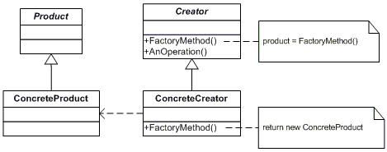
GoF Factory Method
In Factory Method we define a class with an abstract method for creating objects, but we let sub-classes decide which object(s) to actually instantiate.
Let’s take a look at an example: Journal papers
Most of the handling of the paper is the same: printing, sharing, saving, …
But the contents differ according to the version of the paper:
Overviews only hint to the contents of the paper
Short versions contains the goodies, but not all details
Full versions contain everything

Slide 7
GoF Factory Method - example
All handling of general document functions (print, share, save, …) is implemented in the superclass. CreateSections(), the factory method, is abstract
Sections are created by the subclasses’ CreateSections(), which each create a distinct set of Section objects
The different types of sections (products) that the factory methods may produce

Slide 8
The Factory Method
abstract class JournalPaper
{
protected List<ISection> Sections = new List<ISection>();
protected JournalPaper()
{
CreateSections(); // Call factory method
}
protected abstract void CreateSections();
public void Print() { … }
public void Save() { … }
public void Share() { … }
}
class Overview : JournalPaper
{
protected override void CreateSections()
{
Sections.Add(new Abstract());
Sections.Add(new References());
}
}
class FullPaper : JournalPaper
{
protected override void CreateSections()
{
Sections.Add(new Abstract());
Sections.Add(new Introduction());
Sections.Add(new Methods());
Sections.Add(new Results());
Sections.Add(new Discussion());
Sections.Add(new Conclusion());
Sections.Add(new Acknowledgements());
Sections.Add(new References());
}
}

Slide 9
The “products” of the factory
interface ISection
{
void Print();
}
class Abstract : ISection
{
public void Print() => Console.WriteLine("Abstract");
}
class Introduction : ISection
{
public void Print() => Console.WriteLine("Introduction");
}
class Methods: ISection
{
public void Print() => Console.WriteLine("Methods");
}
class Conclusion: ISection
{
public void Print() => Console.WriteLine("Conclusion");
}
class Acknowledgements : ISection
{
public void Print() => Console.WriteLine("Acknowledgements");
}

Slide 10
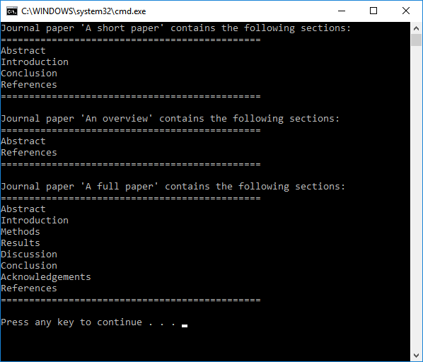
GoF Factory Method
static void Main(string[] args)
{
JournalPaper paper = new ShortPaper("A short paper");
paper.Print();
paper = new Overview("An overview");
paper.Print();
paper = new FullPaper("A full paper");
paper.Print();
}
class ShortPaper : JournalPaper
{
protected override void CreateSections()
{
Sections.Add(new Abstract());
Sections.Add(new Introduction());
Sections.Add(new Conclusion());
Sections.Add(new References());
}
}
class Overview : JournalPaper
{
protected override void CreateSections()
{
Sections.Add(new Abstract());
Sections.Add(new References());
}
}
class FullPaper : JournalPaper
{
protected override void CreateSections()
{
Sections.Add(new Abstract());
Sections.Add(new Introduction());
Sections.Add(new Methods());
Sections.Add(new Results());
Sections.Add(new Discussion());
Sections.Add(new Conclusion());
Sections.Add(new Acknowledgements());
Sections.Add(new References());
}
}

Slide 11
Simple Factory

Slide 12
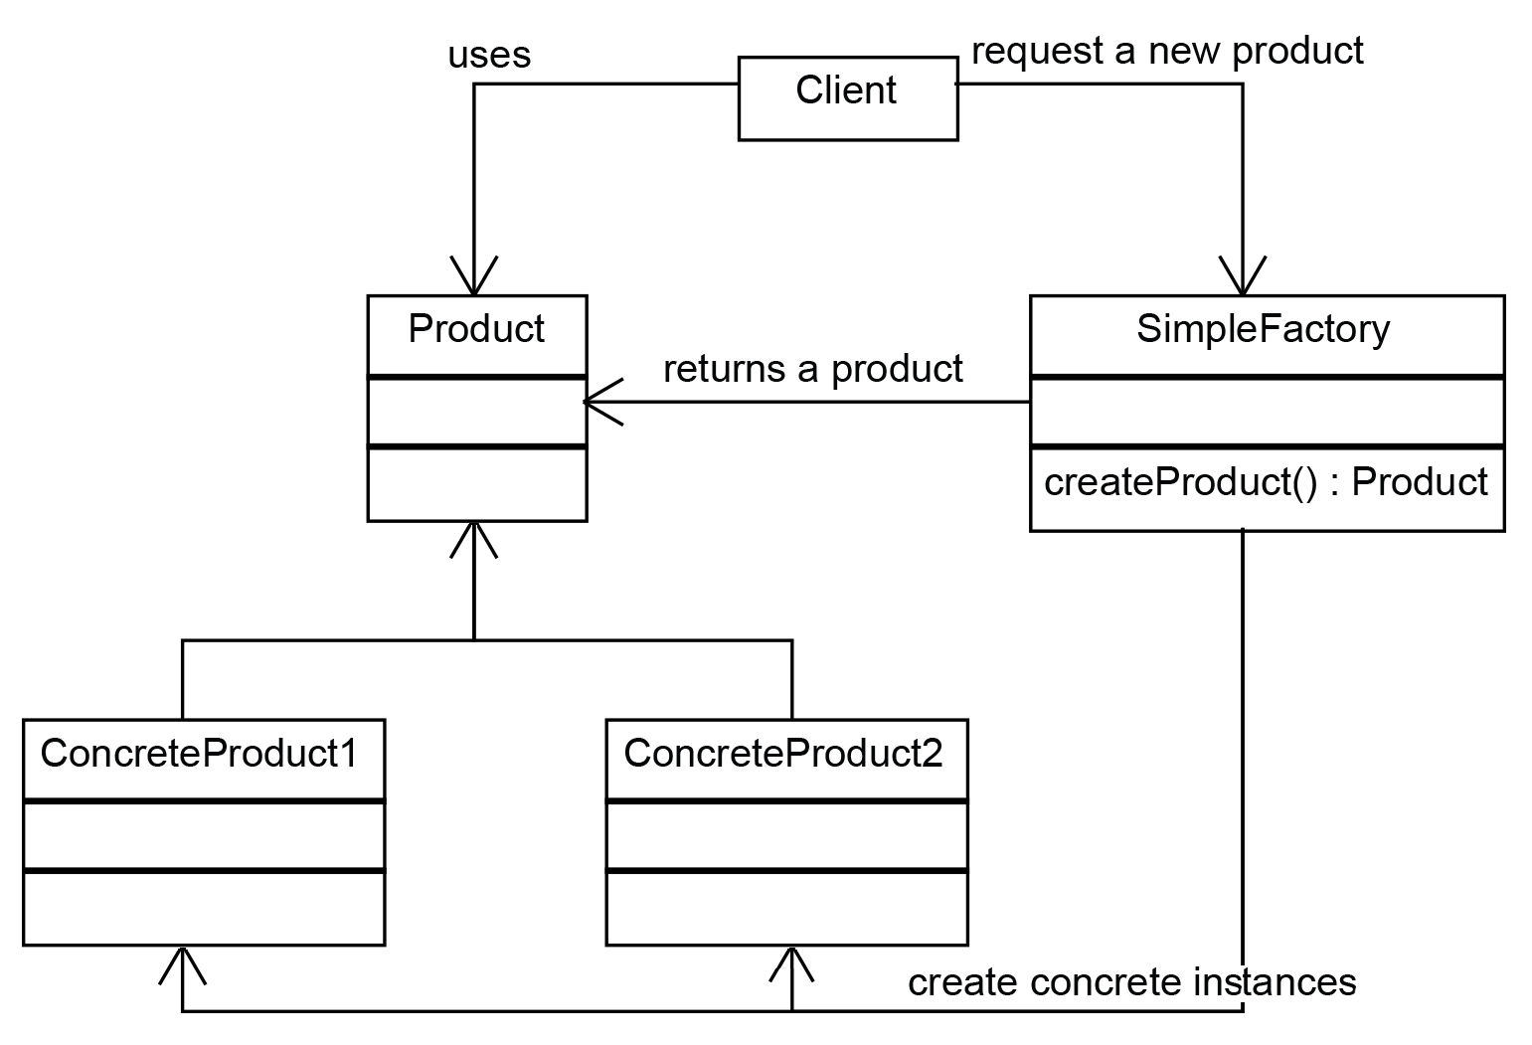
Simple Factory
Simple Factory: Object creation is separated into a stand-alone factory class which can create different concrete objects of same “kind” (interface or abstract class)
Image src: https://www.oreilly.com/library/view/design-patterns-and/9781786463593/31537f95-c052-4b37-97ca-6d0c429c28dd.xhtml

Slide 13
Simple Factory
The “kind” of object is usually specified using a descriptor (a string) which is passed to the Simple Factory’s createXXX()-method
This means that the configuration of a system may be described e.g. in a file which is read at start-up and which configures the system.
Simple Factory makes the system highly extensible
Need a new type of product? Just add it as a sub-class of the product and add a descriptor for it in the factory.

Slide 14
Simple Factory – an example
Let’s take a look at the Hospital Bed example/exercise
Different ways to filter:
Raw (input = output)
3 identical input samples in a row => change of output
…
Different ways to alarm
Buzzer
Light
Text message (SMS)
Email
…

Slide 15
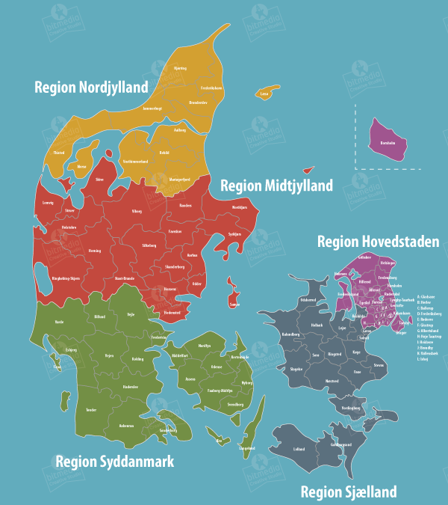
Simple Factory – an example
Assume all regions in Denmark have bought your system, but with different setups
Filter: Raw
Alarm: Buzzer
Filter: 3-sample
Alarm: SMS
Filter: 3-sample
Alarm: Email
Filter: 3-sample
Alarm: Light
Filter: Raw
Alarm: SMS
How can you handle this in software?

Slide 16
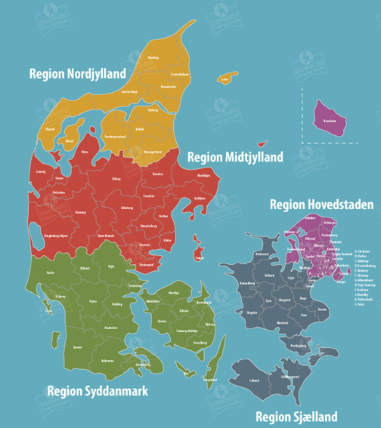
Simple Factory – an example
5 different application projects, each containing exactly the software they need
HospitalBed.
Application.
Nordjylland
HospitalBed.exe
HospitalBed.
Application.
Midtjylland
HospitalBed.exe
How do the projects differ?
How does this approach work in terms of…
Maintainability, e.g. updates?
Testability?
Changes to configuration?
HospitalBed.
Application.
Sydjylland
HospitalBed.exe
HospitalBed.
Application.
Sjælland
HospitalBed.exe
HospitalBed.
Application.
Hovedstaden
HospitalBed.exe

Slide 17
Simple Factory – an example
1 application library containing all code, referenced by 5 different application projects
HospitalBed.
Application.
Nordjylland
HospitalBed.exe
HospitalBed.
Application.
Midtjylland
HospitalBed.exe
HospitalBed
HospitalBed.
Application.
Sydjylland
HospitalBed.dll
HospitalBed.exe
How do the projects differ?
How does this approach work in terms of…
Maintainability, e.g. updates?
Testability?
Changes to configuration?
HospitalBed.
Application.
Sjælland
HospitalBed.exe
HospitalBed.
Application.
Hovedstaden
HospitalBed.exe

Slide 18
Simple Factory – an example
1 application library containing all code, referenced by 1 application project which is configured by 5 individual text files
HospitalBed.exe
HospitalBed.exe
HospitalBed
HospitalBed.
Application
HospitalBed.exe
HospitalBed.dll
HospitalBed.exe
Nordjylland.txt
HospitalBed.exe
Filter: Raw
Alarm: Buzzer
Filter: Raw
Alarm: SMS
Hovedstaden.txt
Midtjylland.txt
Filter: 3-sample
Alarm: Email
Filter: 3-sample
Alarm: Light
Sjælland.txt
Sydjylland.txt
Filter: 3-sample
Alarm: SMS

Slide 19

Simple Factory – an example
Time for some code…

Slide 20

Questions?

